Slide 1
PHONETICS
& OTHER SCIENCES
LINGUISTIC SCIENCES
NON-LINGUISTIC SCIENCES
GRAMMAR
LEXICOLOGY
ORTHOGRAHPY
STYLISTICS
PHYSICS
SOCIOPHONETICS
PSYCHOLOGY
KINESICS
PHYSIOLOGY
ANATOMY
MATHEMATICS
STATISTICS
COMPUTER SCIENCE

Slide 2
PHONETICS &
GRAMMAR
are connected through
system of rules of reading which makes it possible to pronounce correctly past tense forms of regular verbs, singular and plural forms of nouns, etc.
intonation component
e.g., the intonation in interrogative and affirmative sentences is different
sound interchange which can be observed in the category of number
He is \here.
He is /here?
books [-s]
flyers [-z]
witches [-iz]
leaf – leaves
[li:f] – [li:vz]

Slide 3
PHONETICS &
LEXICOLOGY
are connected because
the presence of stress in the right place helps to distinguish parts of speech
NOUNS - VERBS
ADJECTIVES - VERBS
HOMOGRAPHS
an ‘accent – to ac’cent
an ‘object – to ob’ject
‘separate – to sepa’rate
‘graduate – to gradu’ate
read [ri:d] – [red]
wind [wɪnd] – [wаɪnd]

Slide 4
PHONETICS &
ORTHOGRAPHY
are connected because
phonetics formulates the rules of pronunciation of separate sounds and sounds combinations
The rules of reading are based on the relation of sounds to orthography and present certain difficulties in learning English, especially on the initial stages of studying.
OUGH
[oʊ]
[uː]
[ʌf]
[ɒf]
[ɔː]
[aʊ]

Slide 5
PHONETICS &
STYLISTICS
are connected because
phonetics studies sounds, articulation, rhythmics and intonation, while stylistics concentrates on expressive sound combinations, intonational and rhythmic patterns
Peter Piper picked a pack of pickled pepper.
ALLITERATION

Slide 6
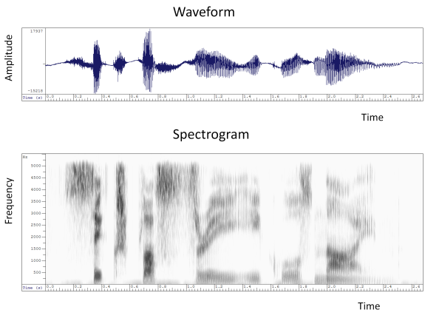
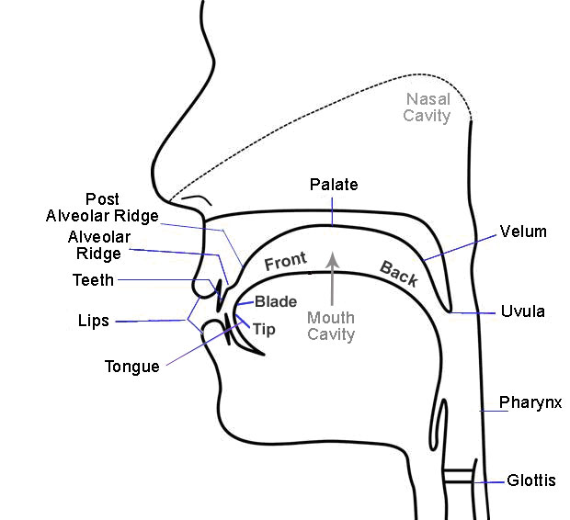
PHONETICS &
are connected through
PHYSICS,
PHYSIOLOGY,
ANATOMY
the methods of investigation of some aspects of phonetics

Slide 7
PHONETICS &
SOCIOPHONETICS
are connected because
sociophonetics studies the way in which pronunciation interacts with society

Slide 8
PHONETICS &
PSYCHOLOGY
are connected because
psycholinguistics studies:
the acquisition of language by children,
the extent to which language meditates or structures thinking,
the extent to which language is influenced and itself influences such things as memory, attention, perception,
the problems of speech production and speech perception,
speech pathology

Slide 9
PHONETICS &
KINESICS
are connected because
the analysis of spoken discourse often includes references both to the phonetics and non-verbal aspects of speech communication, which are studied by kinesics

Slide 10
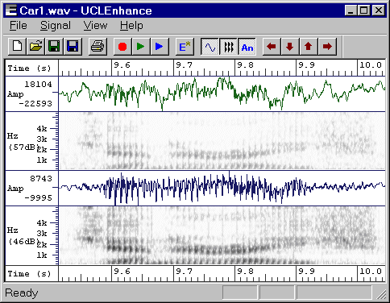
PHONETICS &
are connected because
MATHEMATICS,
STATISTICS,
COMPUTER SCIENCE
they are used in phonetic research

