Slide 1
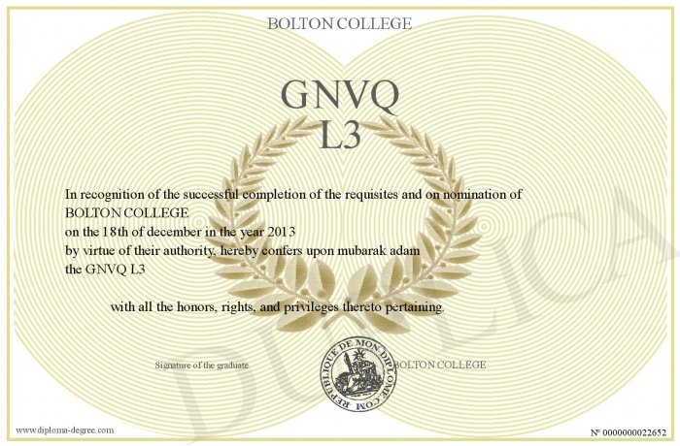
GNVQ

Slide 2
GNVQ
General National Vocational Qualifications was a certificate of vocational education in the UK.
was used for those who wished to further their education within the sixth form but not at an A-level standard;
appeared in the 1st half of 1990s;
ceased to be offered in late 2007.

Slide 3
GNVQ
Intermediate
Level
Advanced Level
= 4 GCSEs
= 2 A levels
GNVQs could be studied alongside GCSEs or A levels.

Slide 4
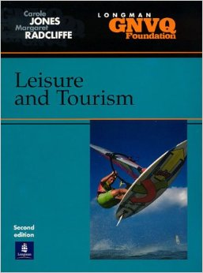
GNVQ
Three main subjects:
Engineering
Health and Social Care
Leisure and Tourism

Slide 5
GNVQ
The Intermediate GNVQ → BTEC (Business and Technology Education Council) First Diplomas.
The Advanced GNVQ → Vocational Certificate of Education.

Slide 6
Thank you for you attention!

